Slide 1


Trump’s tweets v. the S&P500
Group 7: Jared Madris, jenny yi, Nathan Mace, Stephanie ROman

Slide 2
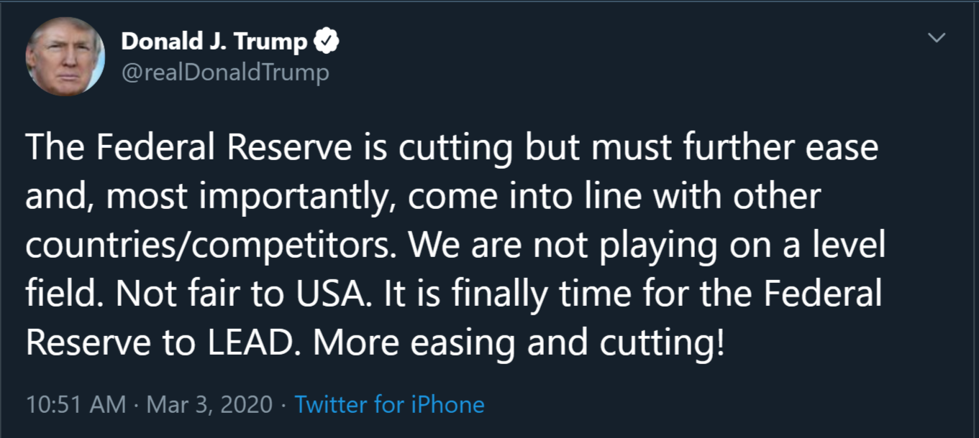
RESEARCH background
CONTEXT
On March 3rd 2020, the S&P 500 had fallen 8.7% from its high in less than a month. This was an unprecedented drop, fueled by fears of the novel COVID spreading around the world. Trump publicized a tweet:
He was indicating that the fed will cut rates. That same day, Jerome Powel announced an emergency half-percentage rate cut.
Notes:
On March 3rd the SP had taken a dramatic hit. Is was down a significant amount in a very short amount of time. Trump publicized a Tweet that morning.

Slide 3
RESEARCH background
CONTEXT
On March 3rd 2020, the S&P 500 had fallen 8.7% from its high in less than a month. This was an unprecedented drop, fueled by fears of the novel COVID spreading around the world. Trump publicized a tweet:
He was indicating that the fed will cut rates. That same day, Jerome Powel announced an emergency half-percentage rate cut.
Notes:
He sent that tweet during the market.

Slide 4
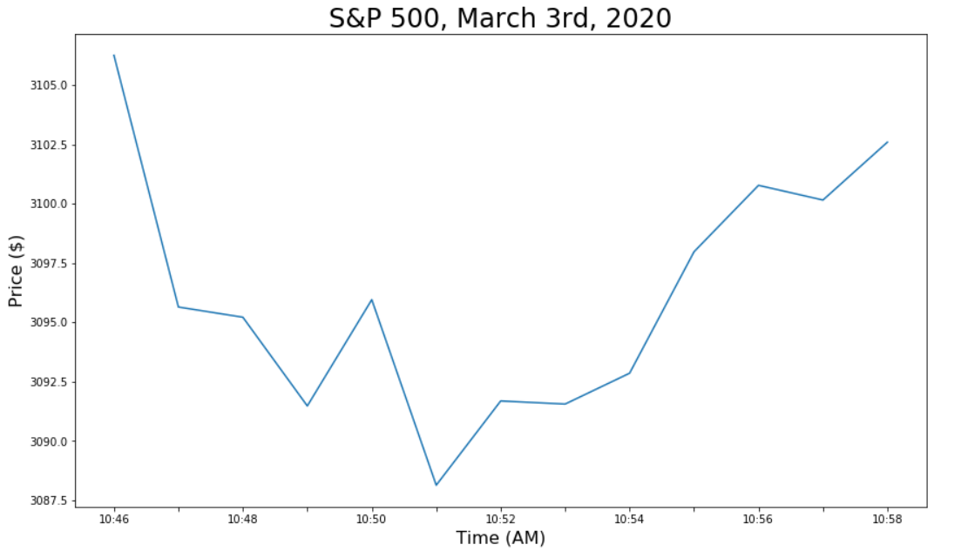
Research background

Slide 5

Research background
Notes:
Theres a strong reversal upwards. Now, the market ended up far lower by the end of the day. But there is definitely an incentive to want to capitalize on these movements

Slide 6
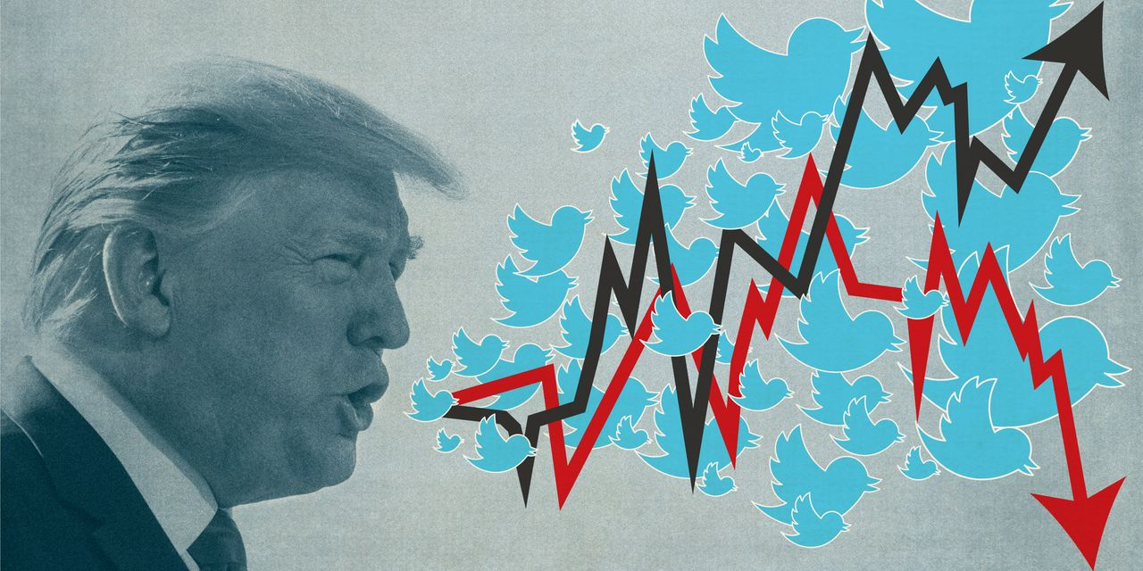
Can machine learning help us predict market movements?
SPECIFICALLY..
Can we use ML and NLP to build and train a model that determines if there is a relationship between Trump’s tweets vs. S&P 500 movements?

Slide 7


RESEARCH APPROACH
S&P 500 Intraday Data
Trump’s Tweet Data
Extract, Transform, Load
Calculate Volatility of S&P 500 Prices
Data Analytics
Perform NLP Sentiment Analysis on Trump’s Tweets
More NLP!
One Hot Encoding
Profit?
Machine Learning

Slide 8
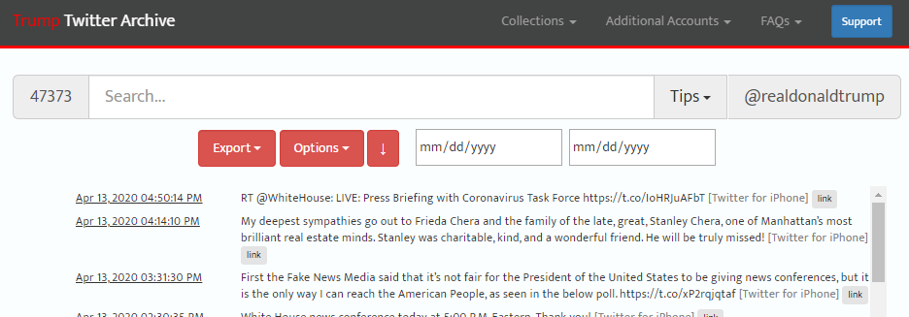
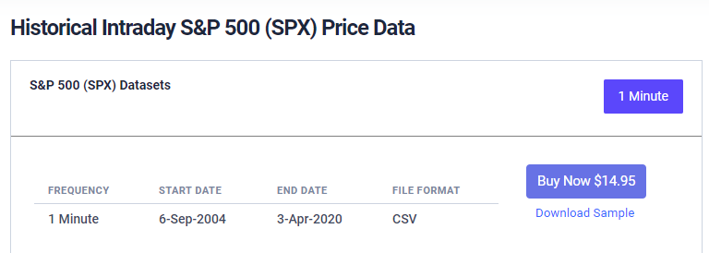
Data sources
Trump’s Tweet Data
1. http://www.trumptwitterarchive.com/archive
S&P 500 Intraday Data
2. https://firstratedata.com/i/index/SPX

Slide 9
RESEARCH APPROACH etl
S&P 500 Intraday Data
Trump’s Tweet Data
Extract, Transform, Load
Calculate Volatility of S&P 500 Prices
Data Analytics
Perform NLP Sentiment Analysis on Trump’s Tweets
More NLP!
One Hot Encoding
Profit?
Machine Learning

Slide 10
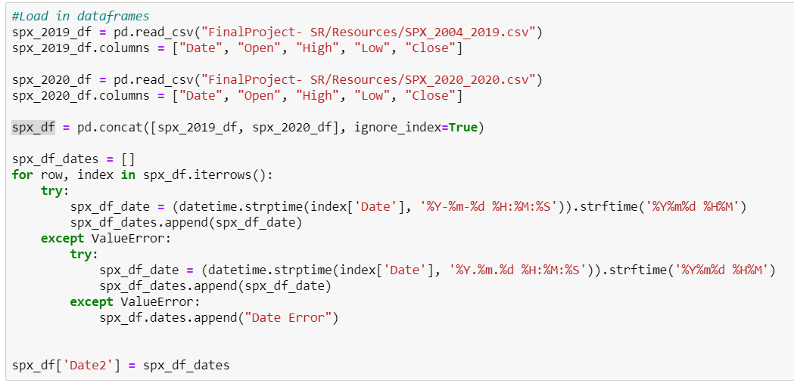
ETL: S&P 500 Data
Notes:
S&P Data was really well structured because we paid for it. The only thing a little strange about it was the change in date format halfway thru. We just made a double try/accept loop to account for this.

Slide 11
RESEARCH APPROACH etl
S&P 500 Intraday Data
Trump’s Tweet Data
Extract, Transform, Load
Calculate Volatility of S&P 500 Prices
Data Analytics
Perform NLP Sentiment Analysis on Trump’s Tweets
More NLP!
One Hot Encoding
Profit?
Machine Learning

Slide 12
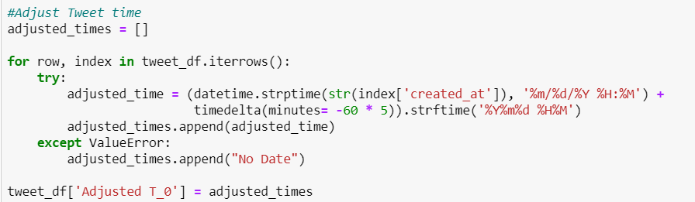
Etl: Trump tweet data
Notes:
Stephanie: Started off with an API but that didn’t work the way we wanted. Moved to csv from website. This was a little less clean than we wanted. We had to subtract 5 hours from the time that was given, and even then, we found instances where some tweets were not sent at the correct time

Slide 13
RESEARCH APPROACH Data analytics
S&P 500 Intraday Data
Trump’s Tweet Data
Extract, Transform, Load
Calculate Volatility of S&P 500 Prices
Data Analytics
Perform NLP Sentiment Analysis on Trump’s Tweets
More NLP!
One Hot Encoding
Profit?
Machine Learning

Slide 14
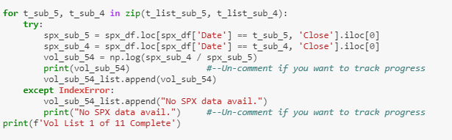
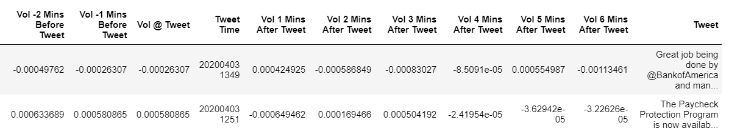

Data analytics: s&p volatility calculation
Volatility $=\ln{\frac{P_{∆t}}{P_{0}}}$
Notes:
Let’s talk about how we want to measure the market moving. Started off with 5 mins after but chose not to do that. Explain why
We chose intra minute volatility to track micro changes in buy or sell activity, rather than larger movements that occur over the course of the day.
This is one approach and by no means the best one. We chose to analyze the volatility before the tweet occurred to see if there was a clear increase or decrease in volatility.

Slide 15
RESEARCH APPROACH Data analytics
S&P 500 Intraday Data
Trump’s Tweet Data
Extract, Transform, Load
Calculate Volatility of S&P 500 Prices
Data Analytics
Perform NLP Sentiment Analysis on Trump’s Tweets
More NLP!
One Hot Encoding
Profit?
Machine Learning

Slide 16
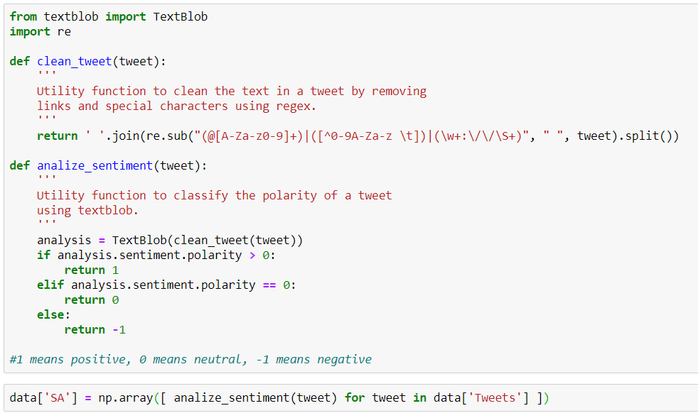

Data analytics: Trump tweet nlp sentiment analysis

Slide 17
RESEARCH APPROACH Machine learning
S&P 500 Intraday Data
Trump’s Tweet Data
Extract, Transform, Load
Calculate Volatility of S&P 500 Prices
Data Analytics
Perform NLP Sentiment Analysis on Trump’s Tweets
More NLP!
One Hot Encoding
Profit?
Machine Learning

Slide 18
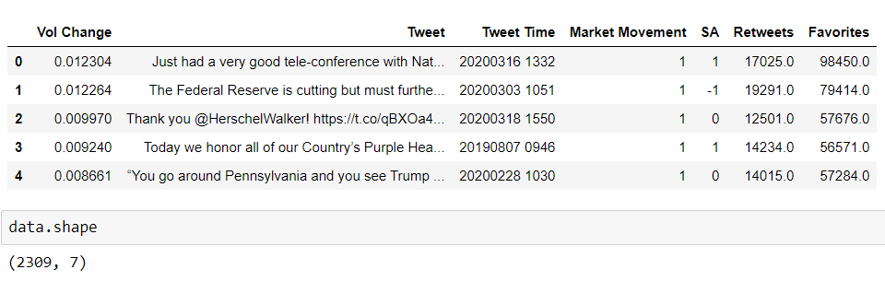
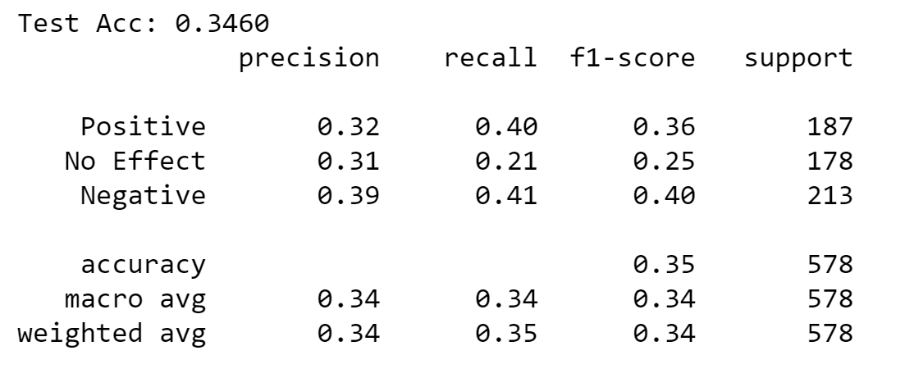
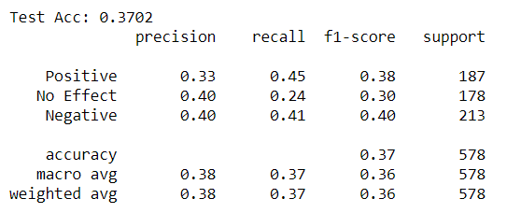
Machine learning: more nlp
Stop Words not removed
Stop Words removed
Notes:
Count vectorizer was used, ngram of 3 words, stop word were not used and then used

Slide 19
Machine learning
S&P 500 Intraday Data
Trump’s Tweet Data
Extract, Transform, Load
Calculate Volatility of S&P 500 Prices
Data Analytics
Perform NLP Sentiment Analysis on Trump’s Tweets
More NLP!
One Hot Encoding
Profit?
Machine Learning

Slide 20
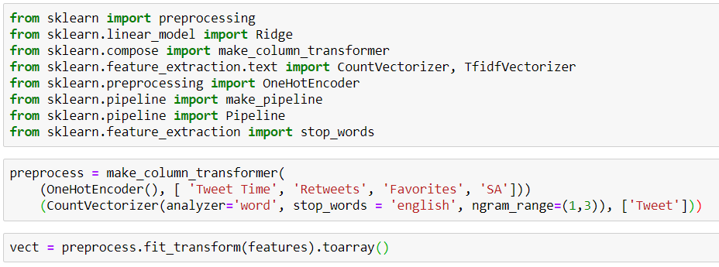
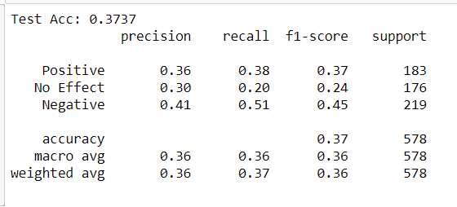
Machine learning: one hot encoding

Slide 21
Machine learning
S&P 500 Intraday Data
Trump’s Tweet Data
Extract, Transform, Load
Calculate Volatility of S&P 500 Prices
Data Analytics
Perform NLP Sentiment Analysis on Trump’s Tweets
More NLP!
One Hot Encoding
Profit?
Machine Learning

Slide 22
Profit?
Well…

Slide 23

Profit?
TBD
Notes:
We still need to set up an API and that feeds in real time information. We would want to also continue training the model and finding the best features.

Slide 24
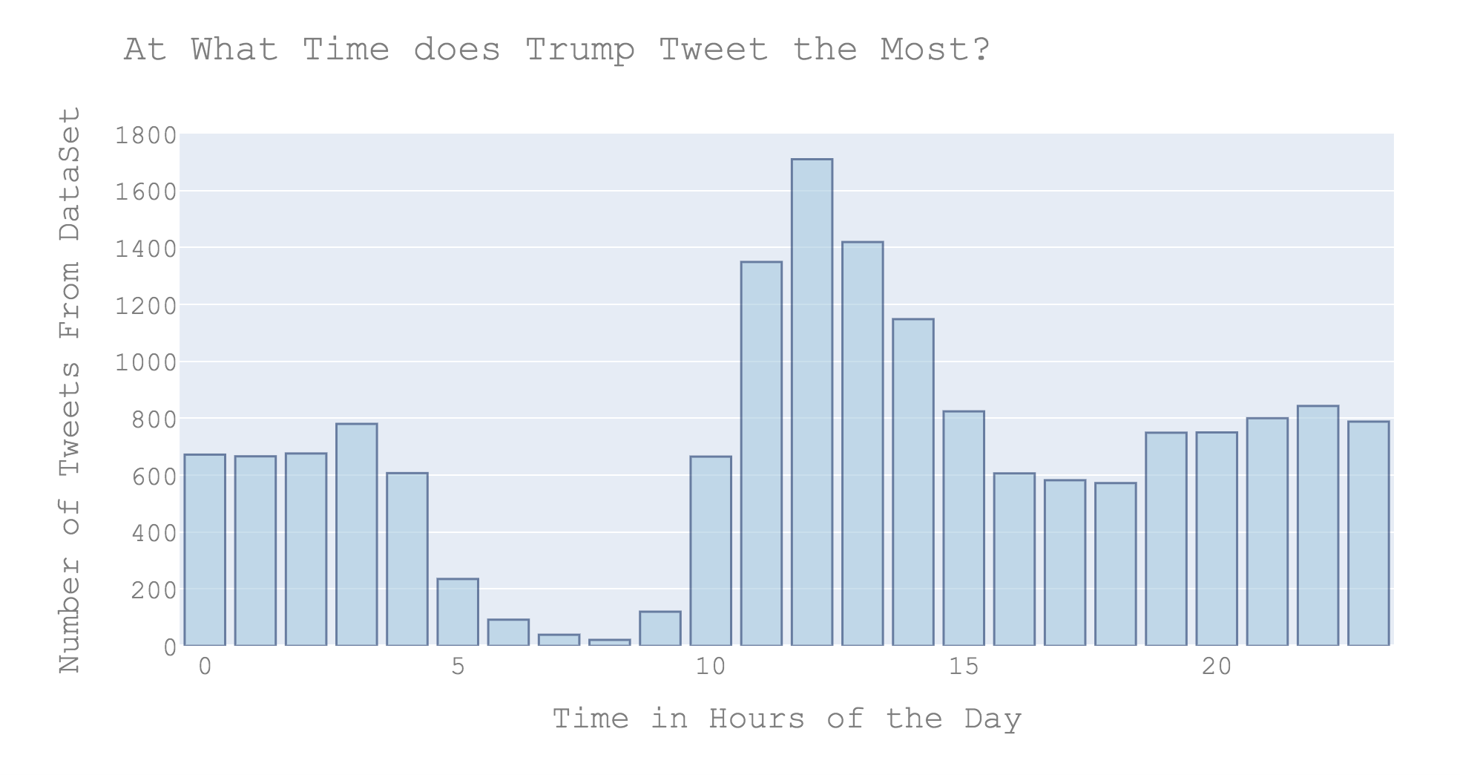
Data exploration

Slide 25
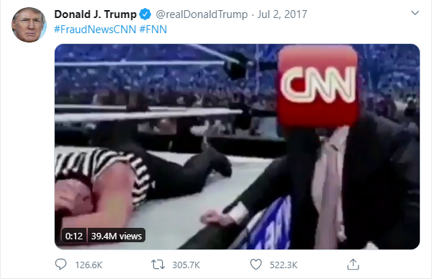
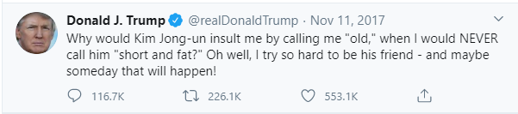
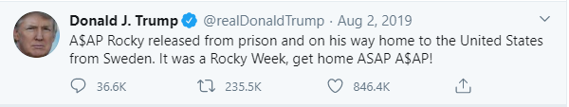
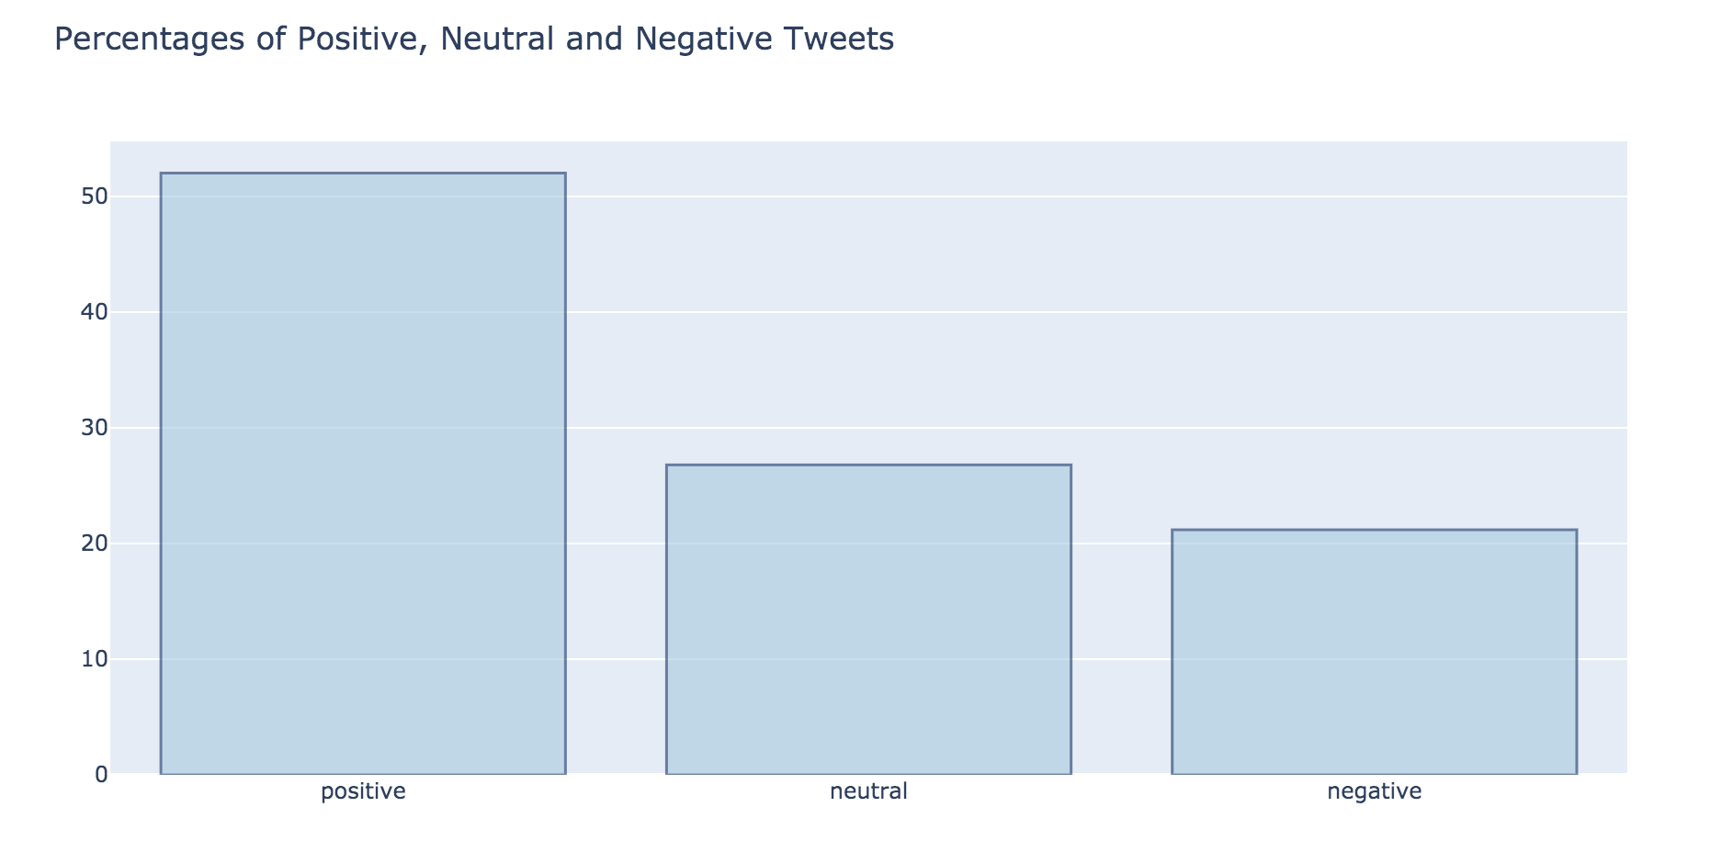
Data exploration
Below are the top 3 most retweeted posts during Trump’s presidency:

Slide 26
Questions?

Slide 27
Thank you!

Slide 28
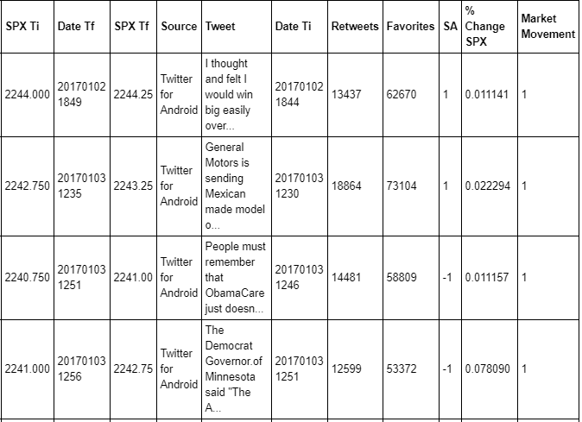
Merged Data
The final data frame combined the Trump’s tweets, sentiment analysis on the tweets, S&P 500 prices, volatility, and market movement direction.

